Slide 1

Fashion Customer Analysis
By Shivani Gupta

Slide 2
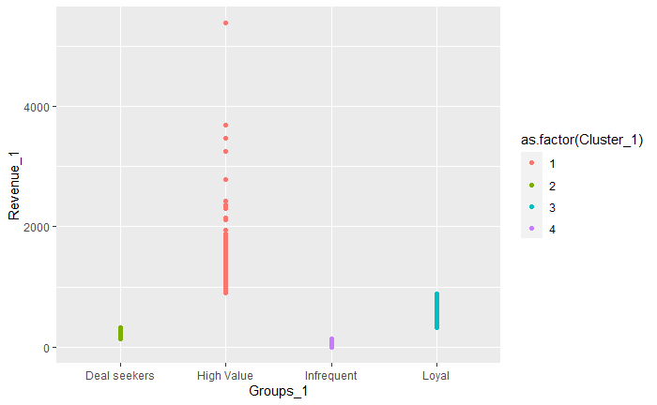
Deal Seekers: Deal Seekers are customers who needs a little push and incentives in terms of sales and deals. They generate revenue in range of 135 to 325 AUD
High Value: High value customers are those customers who generates high values of revenue for the retailer in range of 892 to 5387 AUD
Infrequent: Infrequent customers are those customers who have either not generated any income or have brought revenue to the retailer less than 138 24
Loyal: Loyal customers are the potential customers who are regular in purchasing and generate revenue in range of 326 to 890 AUD

Slide 3
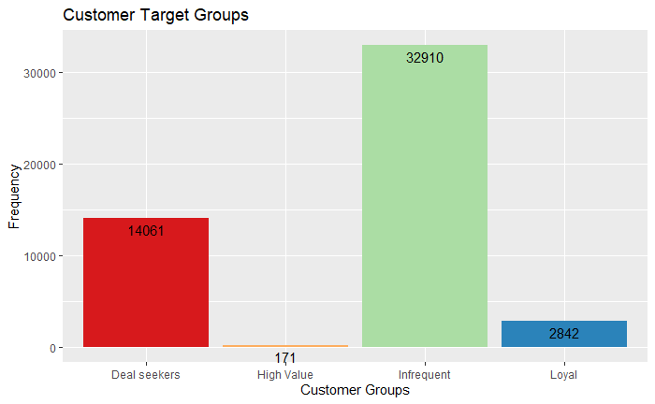
The maximum number of customers
during the analysis period were infrequent
High-value Customers were low in number
Deal Seekers are moderate in number but loyal customers are still few in number

Slide 4
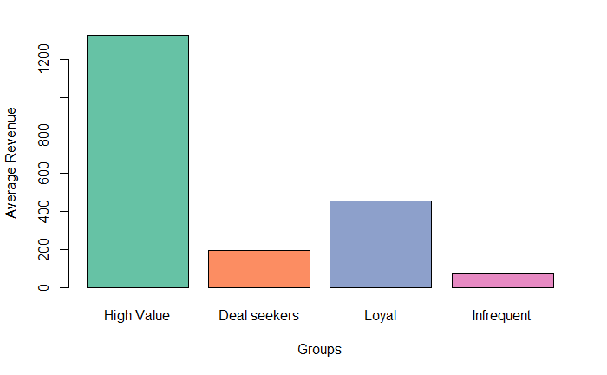
Average Revenue generated by High value customers is 1328.24702 AUD
Average Revenue generated by Deal seekers is 196.90208 AUD
Average Revenue generated by Loyal customers is 455.10944
Average Revenue generated by Infrequent customers is 73.2498 AUD

Slide 5
Evaluation
Client should target Customers in deal seeker group and loyal group, with specific adds and offers as it can help to tap the potential to earn more from them.
Infrequent Customers should be targetted after close monitoring.

